Slide 1

Software Engineering/Development
Training on Computer Programming
ICT Consultancy
AM 8, Abuja Road, By Lagos Street Round About,
Kaduna, Nigeria

Slide 2

KADUNA
Meetup
5th May 2018 https://github.com/hakeemtunde
AbdulHakeem AbdulAleem

Slide 3
Laravel
Framework

Slide 4
PHP FRAMEWORK free open source web framework

Slide 5
Architecture

Slide 6
Object Oriented Programming (OOP)
methodology
Object oriented programming is a paradigm and a way of thinking that helps programmers effectively model real-life scenarios

Slide 7
Intended to be a Model View Controller (MVC) framework
MVC is a software design pattern which ensures clarity on Seperation of Concern (SOLID principle)

Slide 8
Features

Slide 9
Feature: 1
It is relatively easy to get started with

Slide 10
Feature: 2
Easy-to-use interface that handles users authetication
& authorization

Slide 11
Feature: 3
Provide easy-to-use data validation API

Slide 12
Feature: 4
Built-in support for Dependancy Injection/Inversion of Control (DI/IoC) container

Slide 13
Feature: 5
Blade template engine with fluent API

Slide 14
Feature: 6
Built-in toolkit for Database Schema management

Slide 15
Feature: 7
Eloquent: excellent
Database Object Relational Mapping (ORM)

Slide 16
Feature: 8
Artisan command line (CLI) tool: easy code generation package

Slide 17
Feature: 9
Uses composer as a package & library dependency manager

Slide 18
Feature: 10
Good documentation & community

Slide 19
Feature: Summary
It aids in rapid web application development

Slide 20
Components/
Structure

Slide 21
Components
Model
Route/URI
Handler
Controller
View/UI

Slide 22
Component: Design Pattern 1
Model
Route/URI
Handler
Controller
View/UI

Slide 23
Component: Design Pattern 2
Model
Route/URI
Handler
Controller
View/UI

Slide 24
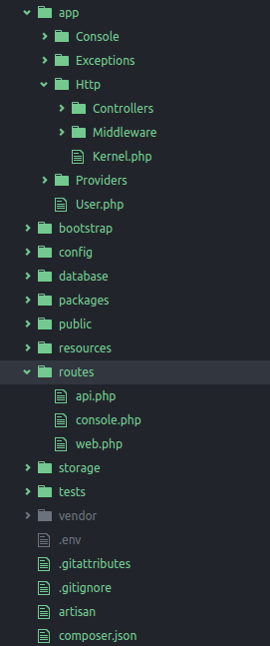
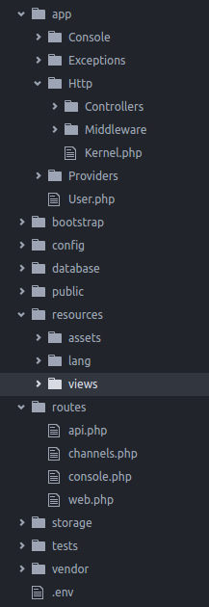
Request/Response
Controller
componenet
Models
component
DB Migrations
component
Views/UI
component
URI Routes
component

Slide 25
Demo laContact web application

